Slide 1
Referees
&
Specialist Assistant Referees
Physical Preparation Plan for Pre-Season
&
Pre-Season Training Programme
Elite Level

Slide 2
Physical Preparation Plan for Pre-Season

Slide 3
Preparation Week 1
 | General Conditioning | Injury Prevention | Functional Conditioning | Cross Training Recovery
Pre-Season -14 |  | Injury Prevention (Exercises 1) |  | Cycling or Swimming (30-45 minutes)
Pre-Season -13 | REST DAY | REST DAY | REST DAY | REST DAY
Pre-Season -12 | High Intensity (Exercise 1) | Injury Prevention (Exercises 2)
Pre-Season -11 | REST DAY | REST DAY | REST DAY | REST DAY
Pre-Season -10 | Speed Endurance (Exercise 1) | Injury Prevention (Exercises 2)
Pre-Season -9 | REST DAY | REST DAY | REST DAY | REST DAY
Pre-Season -8 | High Intensity (Exercise 2) |  | Functional Training (Exercises 1)

Slide 4
Preparation Week 2
 | General Conditioning | Injury Prevention | Functional Conditioning | Cross Training Recovery
Pre-Season -7 |  | Injury Prevention (Exercises 1) |  | Cycling or Swimming (30-45 minutes)
Pre-Season -6 | REST DAY | REST DAY | REST DAY | REST DAY
Pre-Season -5 | High Intensity (Exercise 3) | Injury Prevention (Exercises 2) | Functional Training (Exercises 1)
Pre-Season -4 |  | Injury Prevention (Exercises 1) |  | Cycling or Swimming (30-45 minutes)
Pre-Season -3 |  | Injury Prevention (Exercises 2) | Functional Training (Exercises 1)
Pre-Season -2 | Speed Endurance (Exercise 1) | Injury Prevention (Exercises 1)
Pre-Season -1 | REST DAY | REST DAY | REST DAY | REST DAY

Slide 5
High Intensity
Exercises
Physical Preparation Plan
for Pre-Season

Slide 6
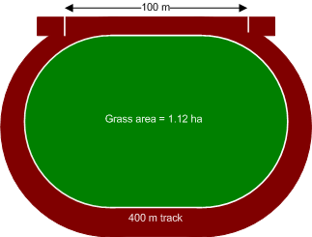
High Intensity Exercise 1
4 sets of 8 HI runs
Start
Key
Red = 90-95% SP_{Max}
Yellow = Walk
Orange = Sprint
Purple = Sideways
Blue = Backwards
Black = Jogging
Session Aim
Aerobic Endurance through Linear Running
*Preferably complete on Grass, however a Running Track will also suffice if no access to grass
Session Components
Sets = 6
Individual set duration = 2 minutes
Recovery between sets = 2 minutes
Session plan = 2 minutes High Intensity (HI) followed by 2 minutes Active Recovery (AR) completed 6 times. (6 x 2” HI / 2” AR)
Intensity = 90-95% Speed Max (SP_{Max}) / 86-93% Heart Rate Max (HR_{Max} )
Key Targets = Maintain a constant pace throughout the duration of the each set. Walk during the recovery.

Slide 7
High Intensity Exercise 2
4 sets of 8 HI runs
S
Key
Red = 90-95% SP_{Max}
Yellow = Walk
Orange = Sprint
Purple = Sideways
Blue = Backwards
Black = Jogging
Session Aim
Aerobic Endurance through Linear Running
*Preferably complete on Grass, however a Running Track will also suffice if no access to grass
Session Components
Sets = 8
Individual set duration = 1 ½ minutes
Recovery between sets = 1 minute
Session Plan = 10 x 1 ½ minutes HI / 1 minute AR
Intensity = 90-95% SP_{Max} / 86-93% HR_{Max}
Key Targets = On the pitch, aim to cover at least a pitch and a half in distance in 1 ½ minutes . On a track look to cover at least 420m in 1 ½ minutes . The 1 minute recovery after each set should be walking back to start position.

Slide 8
High Intensity Exercise 3
4 sets of 8 HI runs
Key
Red = 95% SP_{Max}
Yellow = Walk
Orange = Sprint
Purple = Sideways
Blue = Backwards
Session Aim
Aerobic Endurance through mix of Linear and Multi Directional Running
Session Components
Sets = 4
Recovery between sets = 2 minutes
Individual set duration = (3 minutes total) 30 seconds 95% SP_{Max} – 15 seconds recovery – 30 seconds multidirectional run – 15 seconds recovery [x2]
Session Plan = 5 x 3 minutes HI / 2 minute AR
Intensity = 95% SP_{Max} / 86-93% HR_{Max}
Key Targets = On the pitch, aim to cover 2 circuits of the whole pitch exercises. On a track aim to cover 150m in 30 seconds on the high intensity run, and cover 120m of the multidirectional run in 30 seconds with 15 seconds of walking in between each.

Slide 9
Speed Endurance Exercises
Physical Preparation Plan
for Pre-Season

Slide 10
Speed Endurance Exercise 1
4 sets of 8 HI runs
Key
Red = 95% SP_{Max}
Yellow = Walk
Orange = Sprint
Purple = Sideways
Blue = Backwards
Black = Jogging
Session Aim
Anaerobic Endurance through Linear Running
Session Components
Sets = 4
Recovery between sets = 4-5 minutes
Individual set duration = (2-3 minutes) 2 pitch circuits is 1 set / 1 x 600m track circuit is 1 set: 150m in <26 seconds, 50m walk in <30 seconds [x3 = 600m]
Session Plan = 5 x 2-3 minutes variable / 4-5 minutes AR
Intensity = Walking / Jogging to 95-100% SP_{Max}
Key Targets = On the pitch, aim to complete two circuits in 2 minutes. On the track aim to complete a 600m track circuit within 3 minutes. Once completed 1 set, walk for 4-5 minutes depending on fatigue levels. Should not be starting another set out of breath or heavy legs.

Slide 11
Daily Dietary
Example
Physical Preparation Plan
for Pre-Season

Slide 12
Dietary Example
Time / Day | Breakfast (7-8am) | Snacks (10 –11am) | Lunch (12.30-1.30pm) | Snacks (3pm) | Evening Meal (6-7pm) | Fluids Type/Total
Monday | 1.Porridge with milk and light grazing of honey if desired 2. Drink of choice | 1.Handful of Dried Fruit and Mixed Nuts | 1.Mixed Salad Leaves with tomatoes, cucumber etc and Tuna on top drizzled in light balsamic dressing | 1.Kiwi fruit with chopped apple and banana. | 1.2 x Fillet of White Fish with Courgette Side Salad and Boiled Potatoes 2. Low Fat Yoghurt | 2.5litres of fluid in total with at least 2 litres being water based
Tuesday | 1.2 x Poached Eggs on Wholemeal Toast 2. Drink of Choice | 1.Orange | 1.Roasted Vegetable Cous Cous Salad with Chopped Grilled Chicken Breast | 1. Handful of Dried Fruit and Mixed Nuts | 1.1 x Pork Fillet on a bed of Puy Lentils and side of Boiled Vegetables 2.Fruit Salad | 2.5litres of fluid in total with at least 2 litres being water based
Wednesday | 1.Porridge with milk and light grazing of honey if desired 2. Drink of choice | 1. Handful of Dried Fruit and Mixed Nuts | 1.Mixed Bean, Pasta and Leaf Salad with light dressing and chopped Gammon throughout | 1.Orange and blueberries | 1.2 x Salmon Fillet on a bed of Noodles with Tomato and Cucumber Salad 2. Low Fat Yoghurt | 2.5litres of fluid in total with at least 2 litres being water based
Thursday | 1.2 x Poached Eggs on Wholemeal Toast 2. Drink of Choice | 1.Kiwi Fruit | 1.Rice Salad with Chopped Tomatoes, Cucmber. Red Onion etc. with Salmon Fillet on top | 1. Handful of Dried Fruit and Mixed Nuts | 1. Cold Meat Platter with Pasta and Mixed Salad 2.Fruit Salad | 2.5litres of fluid in total with at least 2 litres being water based
Friday | 1.Porridge with milk and light grazing of honey if desired 2. Drink of choice | 1. Handful of Dried Fruit and Mixed Nuts | 1. Chicken Caesar Salad | 1.Banana, blueberries and cherries | 1.2 x Fillet of Fish with Mash Potatoes and Roasted Vegetables 2.Low Fat Yoghurt | 2.5litres of fluid in total with at least 2 litres being water based
Saturday | 1.2 x Poached Eggs on Wholemeal Toast 2. Drink of Choice | 1.Pear | 1.Greek Tuna, Feta and Pulses Salad with Light Dressing | 1. Handful of Dried Fruit and Mixed Nuts | 1.Meal of choice 2.Fruit Salad | 2.5litres of fluid in total with at least 2 litres being water based
Sunday | 1.Porridge with milk and light grazing of honey if desired 2. Drink of choice | 1.Snack of choice | 1.Cold Mackerel Salad with Mixed Leaves and a light dressing | 1. Pineapple Slices | 1. Roast Chicken with Boiled Potatoes and Vegetables and a Light Gravy 2. Ice Cream | 2.5litres of fluid in total with at least 2 litres being water based

Slide 13
Pre-Season Training Programme
Referees and Specialist Assistant Referees
Elite Level

Slide 14
Week 1
 | Training Session Component 1 (0-45 minutes) | Training Session Component 2 (45-60 minutes) | Training Session Component 3 (60-75minutes) | Cross Training Recovery
DAY 1 | Self-Run Yo-Yo Recovery Test to Exhaustion (Download from Coach Logic) | Injury Prevention (Exercises 1)
DAY 2 |  |  |  | Swimming (30 minutes)
DAY 3 | High Intensity (Exercise 1) | Injury Prevention (Exercises 2)
DAY 4 | Repeated Sprint Ability (Exercise 1) |  | Functional Training (Exercises 1)
DAY 5 |  |  |  | Cycling (30 minutes)
DAY 6 | High Intensity (Exercise 2) | Injury Prevention (Exercises 1) | Functional Training (Exercises 1)
DAY 7 | REST DAY | REST DAY | REST DAY | REST DAY

Slide 15
Week 2
 | Training Session Component 1 (0-45 minutes) | Training Session Component 2 (45-60 minutes) | Training Session Component 3 (60-75 minutes) | Cross Training Recovery
DAY 1 | High Intensity (Exercise 3) | Injury Prevention (Exercises 2)
DAY 2 | Repeated Sprint Ability (Exercise 1) |  | Functional Training (Exercises 1)
DAY 3 | High Intensity (Exercise 4) | Injury Prevention (Exercises 1)
DAY 4 | Repeated Sprint Ability (Exercise 2) |  | Functional Training (Exercises 1)
DAY 5 |  |  |  | Swimming (30 minutes)
DAY 6 | High Intensity (Exercise 2) | Injury Prevention (Exercises 2) | Functional Training (Exercises 1)
DAY 7 | REST DAY | REST DAY | REST DAY | REST DAY

Slide 16
Week 3
 | Training Session Component 1 (0-45 minutes) | Training Session Component 2 (45-60 minutes) | Training Session Component 3 (60-75 minutes) | Cross Training Recovery
DAY 1 | High Intensity (Exercise 3) | Injury Prevention (Exercises 1) | Functional Training (Exercises 1)
DAY 2 |  |  |  | Swimming (30 minutes)
DAY 3 | High Intensity (Exercise 4) | Injury Prevention (Exercises 2) | Functional Training (Exercises 1)
DAY 4 | Repeated Sprint Ability (Exercise 1) |  | Functional Training (Exercises 1)
DAY 5 | Extended Speed (Exercise 1) | Injury Prevention (Exercises 1)
DAY 6 | MATCH (Friendly) | MATCH (Friendly) | MATCH (Friendly) | MATCH (Friendly)
DAY 7 |  | Injury Prevention (Exercises 1) |  | Cycling (30 minutes)

Slide 17
Week 4
 | Training Session Component 1 (0-45 minutes) | Training Session Component 2 (45-60 minutes) | Training Session Component 3 (60-75 minutes) | Cross Training Recovery
DAY 1 | Self-Run Yo-Yo Recovery Test to Exhaustion (Download from Coach Logic) | Injury Prevention (Exercises 1) | Functional Training (Exercises 1)
DAY 2 | Repeated Sprint Ability (Exercise 3) | Injury Prevention (Exercises 2) | Functional Training (Exercises 1)
DAY 3 | High Intensity (Exercise 1) | Injury Prevention (Exercises 1) | Functional Training (Exercises 1)
DAY 4 | Extended Speed (Exercise 2) | Injury Prevention (Exercises 2) | Functional Training (Exercises 1)
DAY 5 | Explosive Speed (Exercise 1)
DAY 6 | MATCH (Friendly) | MATCH (Friendly) | MATCH (Friendly) | MATCH (Friendly)
DAY 7 |  | Injury Prevention (Exercises 1) |  | Cycling (30 minutes)

Slide 18
High Intensity
Exercises
Referees and Specialist Assistant Referees
Pre-Season Training Programme
Elite Level

Slide 19
High Intensity Exercise 1
4 sets of 8 HI runs
>90m in 15 seconds at 95% SP_{Max}
15 seconds recovery walk then repeat
Key
Red = 95% SP_{Max}
Yellow = Walk
Orange = Sprint
Purple = Sideways
Blue = Backwards
Session Aim
Aerobic Endurance through Linear Running
Session Components
Sets = 4
Recovery between sets = 3 minutes
Individual set duration = (4 minutes in total) 15 seconds 95% SP_{Max} – 15 seconds walk [x8]
Intensity = 95% Speed Max (SP_{Max}) / 86-93% Heart Rate Max (HR_{Max} )
Key Targets = On the pitch, aim to cover at least penalty area to penalty area in 15 seconds. On a track, look to cover at least 90m in 15 seconds. 15 seconds following the run should be walking. After 4 minutes of the run has been completed, recover for 3 minutes.

Slide 20
High Intensity Exercise 2
4 sets of 8 HI runs
Key
Red = 95% SP_{Max}
Yellow = Walk
Orange = Sprint
Purple = Sideways
Blue = Backwards
Session Aim
Aerobic Endurance through Linear Running
Session Components
Sets = 15
Recovery between sets = 1 minute
Individual set duration = 1 ½ minutes
Intensity = 95% SP_{Max} / 86-93% HR_{Max}
Key Targets = On the pitch, aim to cover at least a pitch in distance in 1 ½ minutes . On a track look to cover at least 420m in 1 ½ minutes . The 1 minute recovery after each set should be walking back to start position. SAR’s replace backwards running with sideways movements.

Slide 21
High Intensity Exercise 3
4 sets of 8 HI runs
Key
Red = 95% SP_{Max}
Yellow = Walk
Orange = Sprint
Purple = Sideways
Blue = Backwards
Session Aim
Aerobic Endurance through mix of Linear and Multi Directional Running
Session Components
Sets = 8
Recovery between sets = 2 minutes
Individual set duration = 3 minutes
Intensity = 95% SP_{Max} / 86-93% HR_{Max}
Key Targets = On the pitch, aim to cover 2 circuits of the whole pitch exercises. On a track aim to cover 150m in 30 seconds on the high intensity run, and cover 120m of the multidirectional run in 30 seconds with 15 seconds of walking in between each.

Slide 22
High Intensity Exercise 4
4 sets of 8 HI runs
Start
Key
Red = 95% SP_{Max}
Yellow = Walk
Orange = Sprint
Purple = Sideways
Blue = Backwards
Session Aim
Aerobic Endurance through Multi Directional Running
Session Components
Sets = 10
Recovery between sets = 1 ½ minutes
Individual set components= 2 minutes completing one full pitch circuit / track circuit
Intensity = 95% SP_{Max} / 86-93% HR_{Max}
Key Targets = On the pitch, aim to cover at least one full pitch circuit in 2 minutes and repeat this for every set. On a track look to cover at least 400m track circuit in 2 minutes and repeat this level for every set. After each set walk for 1 ½ minutes.

Slide 23
Repeated Sprint Ability Exercises
Referees and Specialist Assistant Referees
Pre-Season Training Programme
Elite Level

Slide 24
Repeated Sprint Ability Exercise 1
4 sets of 8 HI runs
<15m>
<21m>
<5m>
<25m>
Key
Red = 95% SP_{Max}
Yellow = Walk
Orange = Sprint
Purple = Sideways
Blue = Backwards
Black = Jogging
Session Aim
Anaerobic Endurance through Linear Running
incorporating Yo-Yo Test Practice
Session Components
Sets = 6
Recovery between sets = 4-5 minutes
Individual set duration = (2-3 minutes) 2 pitch circuits is 1 set / 1 x 600m track circuit is 1 set: 150m in <26 seconds, 50m walk in <30 seconds [x3 = 600m]
Intensity = Walking / Jogging to 95-100% SP_{Max}
Key Targets = On the pitch, aim to complete two circuits in 3 minutes. On the track aim to complete a 600m track circuit within 3 minutes. Once completed 1 set, walk for 4-5 minutes depending on fatigue levels. Should not be starting another set out of breath or heavy legs.

Slide 25
Repeated Sprint Ability Exercise 2
4 sets of 8 HI runs
Key
Red = 95% SP_{Max}
Yellow = Walk
Orange = Sprint
Purple = Sideways
Blue = Backwards
Black = Jogging
Session Aim
Anaerobic Endurance through mix of Linear and Multidirectional Running
Session Components
Sets = 8
Recovery between sets = 3-4 minutes
Individual set duration = (1-2 minutes ) 2 pitch circuits is 1 set / 1 x 400m track circuit is 1 set: 120m in <20 seconds, 10m walk, 10m sideways and 10m jog in <15 seconds, 40m sprint in <7 seconds and 10m walk in <5 seconds [X2]
Intensity = Walking / Jogging to 95-100% SP_{Max}
Key Targets = On the pitch, aim to complete two circuits in 2 minutes. On the track aim to complete a 600m track circuit within 3 minutes. Once completed 1 set, walk for 4-5 minutes depending on fatigue levels. Should not be starting another set out of breath or heavy legs.

Slide 26
Repeated Sprint Ability Exercise 3
4 sets of 8 HI runs
Key
Red = 95% SP_{Max}
Yellow = Walk
Orange = Sprint
Purple = Sideways
Blue = Backwards
Black = Jogging
Session Aim
Anaerobic Endurance through mix of Linear and Multidirectional Running
Session Components
Sets = 10
Recovery between sets = 3 minutes
Individual set duration = (1-2 minutes) 1 pitch circuit is 1 set / 1 x 400m track circuit is 1 set. 140m in <30 seconds, 50m walk, 50m jog in <30 seconds [X2]
Intensity = Walking / Jogging to 95-100% SP_{Max}
Key Targets = On the pitch, aim to complete 1 circuit in 1 minute. On the track aim to complete a 400m track circuit within 1 ½ minutes. Once completed 1 set, walk for 3 minutes depending on fatigue levels then go again. Should not be starting another set out of breath or heavy legs.

Slide 27
Extended Speed Exercises
Referees and Specialist Assistant Referees
Pre-Season Training Programme
Elite Level

Slide 28
Extended Speed Exercise 1
4 sets of 8 HI runs
30m
45m
60m
75m
Key
Red = 95% SP_{Max}
Yellow = Walk
Orange = Sprint
Purple = Sideways
Blue = Backwards
Session Aim
Sprinting Speed and Running Technique over distance
Session Components
Sets = 4
Recovery between sets = 4 minutes
Individual set duration = 2 minutes
Intensity = 100% SP_{Max}
Key Targets = On the pitch or running track, aim to achieve maximum speed in quickest time and maintain this speed to the set distance. Keep the same discipline for the shorter sprints as is given for the longer sprints.

Slide 29
Extended Speed Exercise 2
4 sets of 8 HI runs
80m
40m
70m
35m
Key
Red = 95% SP_{Max}
Yellow = Walk
Orange = Sprint
Purple = Sideways
Blue = Backwards
Session Aim
Sprinting Speed and Running Technique over distance
Session Components
Sets = 4
Recovery between sets = 4 minutes
Individual set duration = 2 minutes
Intensity = 100% SP_{Max}
Key Targets = On the pitch or running track, aim to achieve maximum speed in quickest time and maintain this speed to the set distance. Keep the same discipline for the shorter sprints as is given for the longer sprints.

Slide 30
Explosive Speed
Exercises
Referees and Specialist Assistant Referees
Pre-Season Training Programme
Elite Level

Slide 31
Explosive Speed Exercise 1
4 sets of 8 HI runs
1
2
3
4
10m
10m
15m
15m
10m
10m
35m
25m
20m
15m
20m
5
Key
Red = 95% SP_{Max}
Yellow = Walk
Orange = Sprint
Purple = Sideways
Blue = Backwards
Session Aim
Explosive Sprinting Speed
Session Components
Sets = 4
Recovery between sets = 4 minutes
Individual set duration = 1 minute
Intensity = 100% SP_{Max}
Key Targets = On the pitch or running track, aim to achieve maximum speed in quickest time and expload away from a starting position on each occasion.

Slide 32
Injury Prevention
Exercises
(As seen on ‘Video Room’ – Coach Logic)
Referees and Specialist Assistant Referees
Pre-Season Training Programme
Elite Level

Slide 33
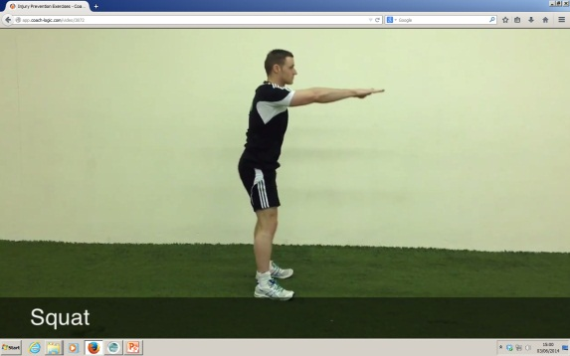
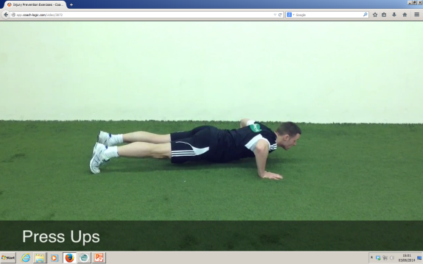
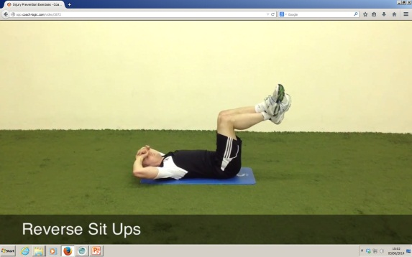
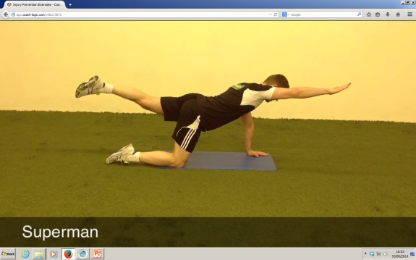
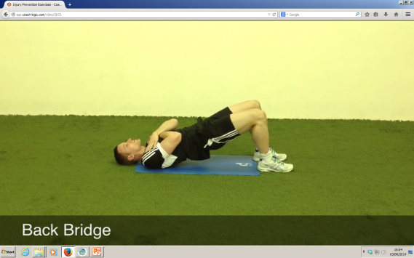
Injury Prevention Exercises 1
4 sets of 8 HI runs
10m
10m
10m
35m
25m
20m
Session Aim
Core Strengthening and Injury Prevention
Session Components
Sets = 3
Recovery between sets = 30 seconds
Individual set duration = 30 seconds
Intensity = Moderate
Key Targets = Look at the videos on the Coach Logic website and depending on your strength, work to the appropriate exercise whether its the basic or ‘progression’ exercise.

Slide 34
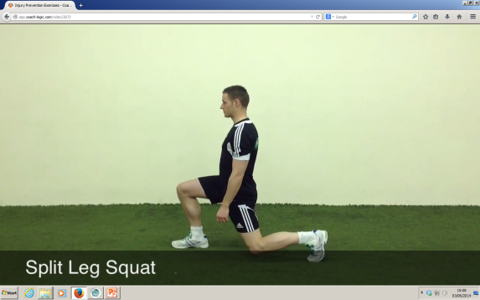
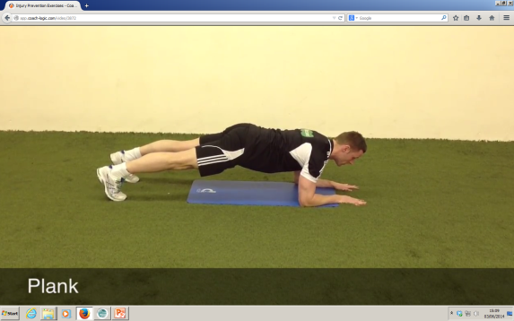
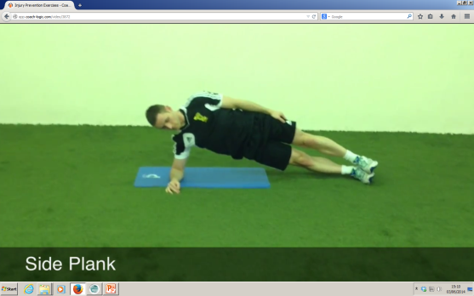
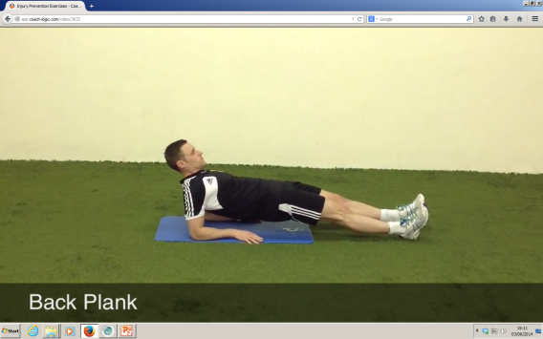
Injury Prevention Exercises 2
4 sets of 8 HI runs
10m
10m
10m
35m
25m
20m
Session Aim
Core Strengthening and Injury Prevention
Session Components
Sets = 3
Recovery between sets = 30 seconds
Individual set duration = 30 seconds
Intensity = Moderate
Key Targets = Look at the videos on the Coach Logic website and depending on your strength, work to the appropriate exercise whether its the basic or ‘progression’ exercise.

Slide 35
Functional Training
Exercises
As seen on: ‘http://www.youtube.com/watch?v=POdzasJklxw’
Referees and Specialist Assistant Referees
Pre-Season Training Programme
Elite Level

Slide 36
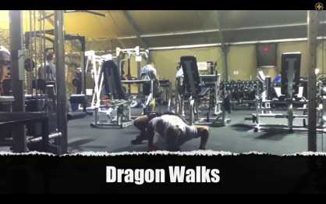
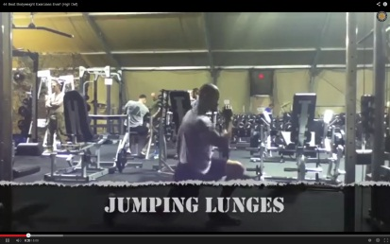
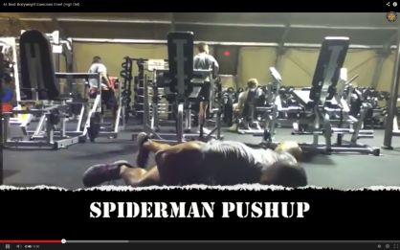
Functional Training Exercises 1
4 sets of 8 HI runs
10m
10m
10m
35m
25m
20m
Session Aim
Full Body Muscular Strengthening and Conditioning
Session Components
Sets = 2
Recovery between sets = 2 minutes / 30 seconds between exercises
Individual set duration = 30 seconds
Intensity = Maximal
Key Targets = Look at the videos on the You Tube website from the link on the page before, working at a maximal effort complete 2 sets of the 8 exercises. Take 30 seconds between each exercise and 2 minutes recovery after the first set.

